Slide 1
Typed Data in Drupal?
Let’s try to understand it. Finally …
Piotr Pakulski
Notes:
- thank you for comming
- today I'm going to talk about

Slide 2
Piotr Pakulski
I am from Łódź Poland
Drupal Developer at BOX.com
Remotly with team from Redwood City
Developer for around 12+ years now
With Drupal starting from late version 7
Used to be Symfony 2.x developer
https://www.drupal.org/u/piotr-pakulski
https://www.linkedin.com/in/pakulski-piotr/
Notes:
remotely Redwood
responsible for
1999
explained in a simple way.

Slide 3
Thank you DCP !
Notes:
thank you Florida Drupal Camp team
in love with Florida and Orlando.
Long trip

Slide 4
The agenda
Why?
How?
Content entities
Use cases
Questions

Slide 5
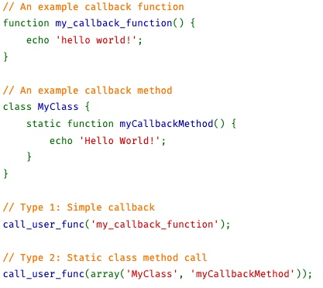
How good you know PHP ?
Anyone knows how many variable build-in types PHP has?
Notes:
9
Expect?
Remarkable ?

Slide 6
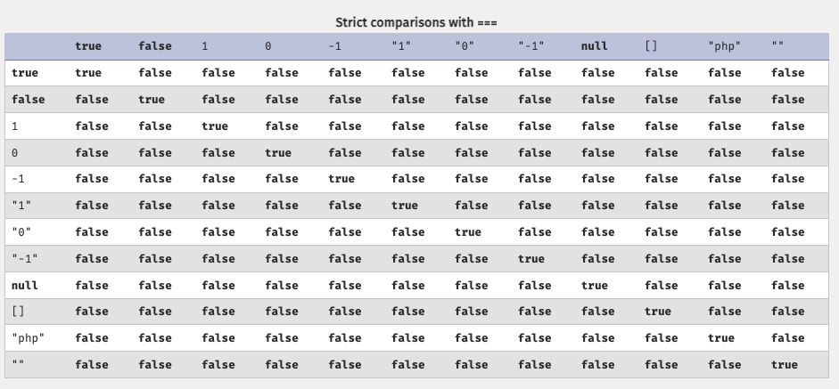
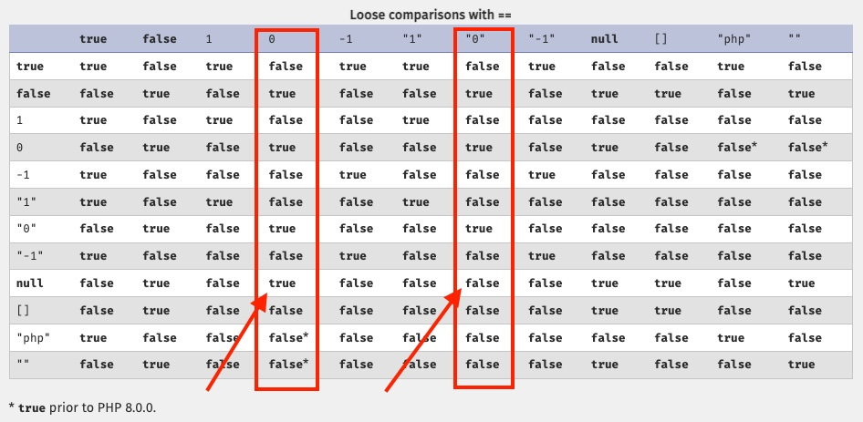
How good you know PHP ?
PHP is a dynamically typed language

Slide 7
How good you know PHP ?
PHP is a dynamically typed language

Slide 8
Why we need TypedData?
We can not realy of the type of certain data
1 === “1” is not TRUE
so we either use == which is not good
Let’s examine 1495875076 and 24958770776
However, in some cases, it is useful to be able to define an abstract type
Notes:
? what we get ?
Compare had
Not good

Slide 9
History - the problem with Drupal 7
No consistent way defining data type (timestamp? String?)
Can not easly say if field is translatable
Access levels hard to define (who can edit/add/delete)
Validaton problems – famous hook_filed_validate
Hard to build machine readable API for data access (see D7 REST module)
Notes:
timestamp ? String? Translatable?
If translatable
which user roles can view edit or delete the data
Validation very coupled to the form API
investigating D7 REST module

Slide 10
More history background
https://www.drupal.org/project/drupal/issues/1696640
Notes:
Community knows
initiative

Slide 11
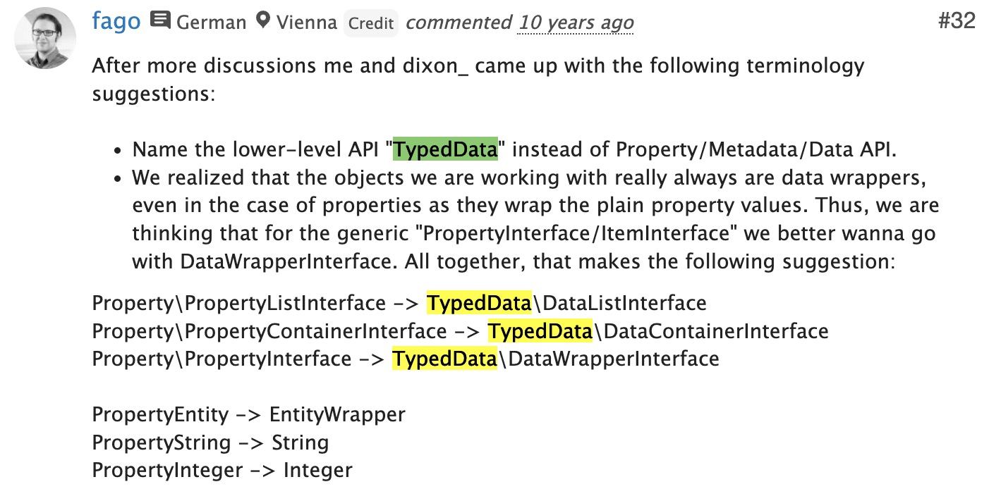
More history background
https://www.drupal.org/project/drupal/issues/1696640
Notes:
Community knows
initiative

Slide 12
More history background
https://www.drupal.org/project/drupal/issues/1696640
Notes:
Community knows
initiative

Slide 13
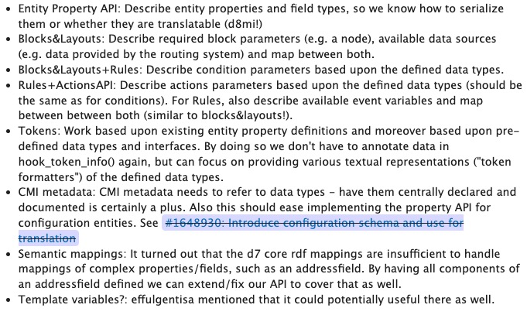
More history background
https://www.drupal.org/project/drupal/issues/1696640
Notes:
Community knows
initiative

Slide 14
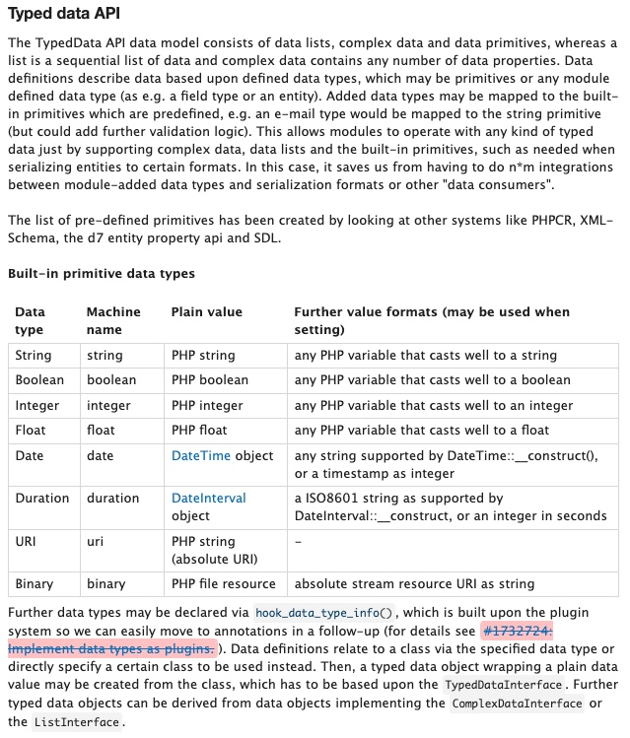
More history background
https://www.drupal.org/project/drupal/issues/1696640

Slide 15
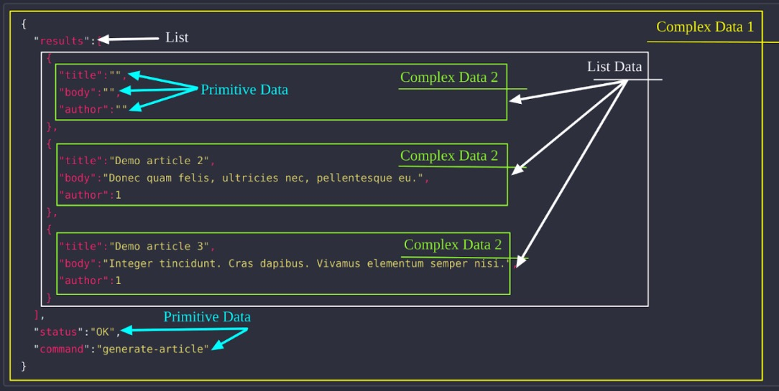
More history background
https://www.drupal.org/project/drupal/issues/1696640

Slide 16
More history background
https://www.drupal.org/project/drupal/issues/1696640
https://www.drupal.org/project/drupal/issues/1777268
Notes:
Community knows
initiative

Slide 17
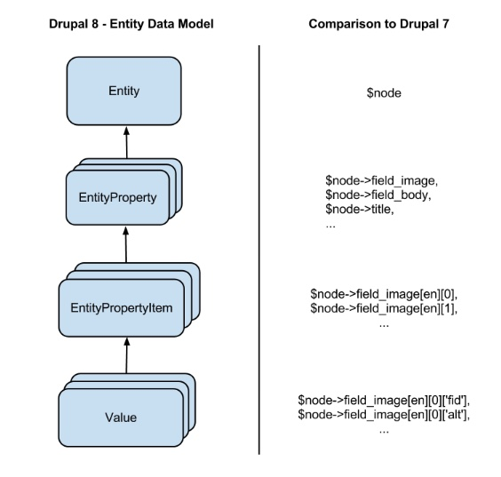
Wellcome Typed Data API in D8
Notes:
Abstraction layer

Slide 18
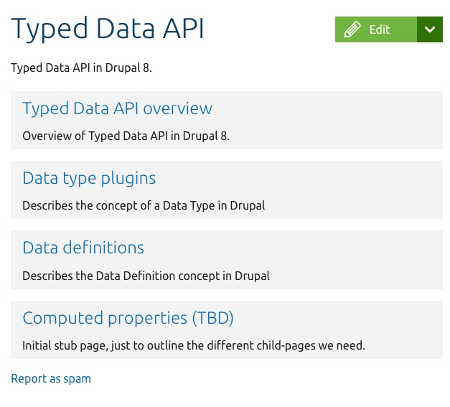
TypedData on Drupal.org

Slide 19
TypedData on Drupal.org

Slide 20
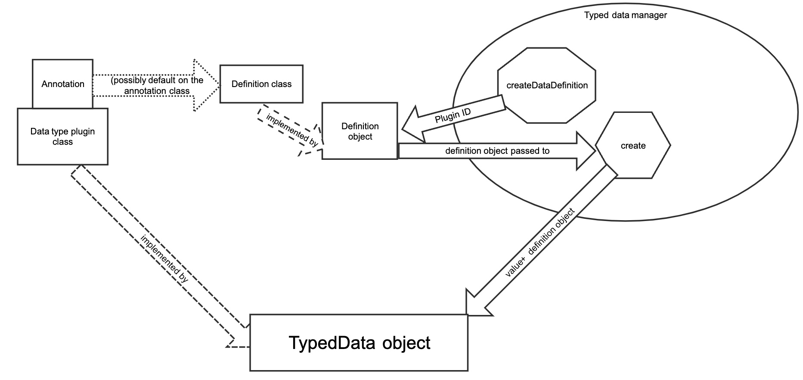
TypedData on Drupal.org
Notes:
DIAGRAM
chicken

Slide 21
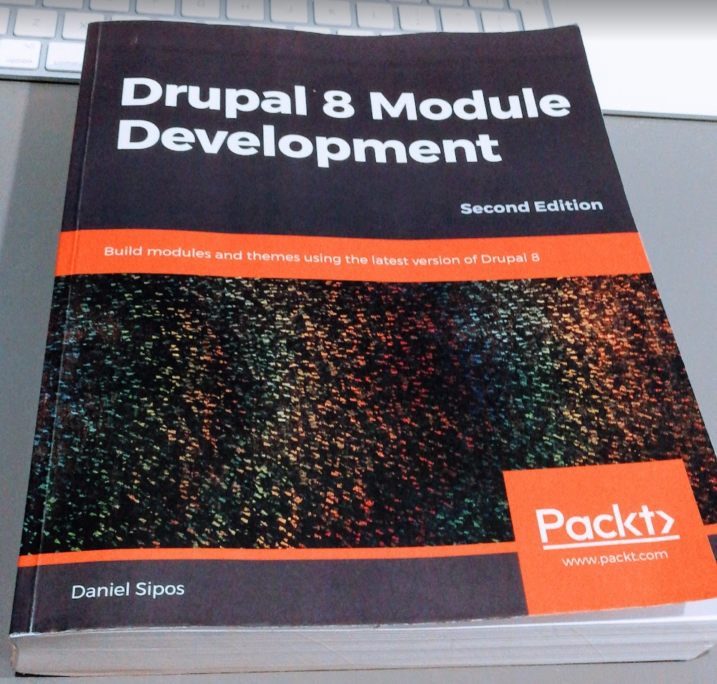
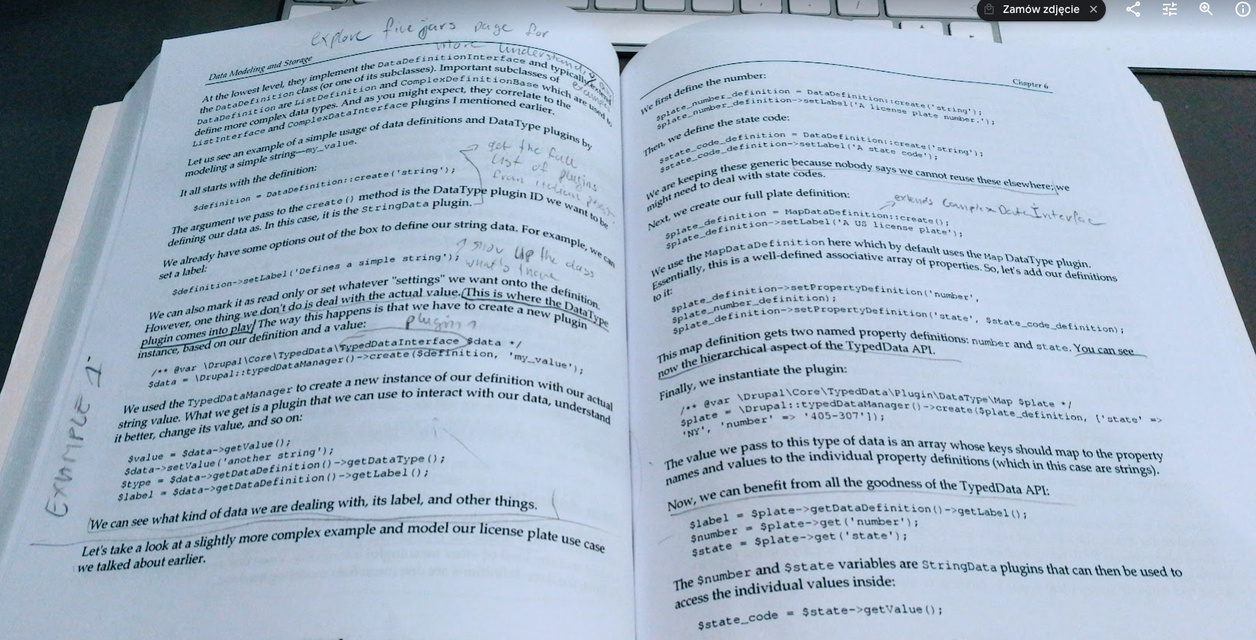
TypedData by Daniel Sipos
Notes:
Great book
Read it
Family & coffe
7 pages
Difficult section to follow

Slide 22
What is TypedData ?
First: it wraps values of any kind of complexity
Second: it gives meaning to the data it wraps

Slide 23
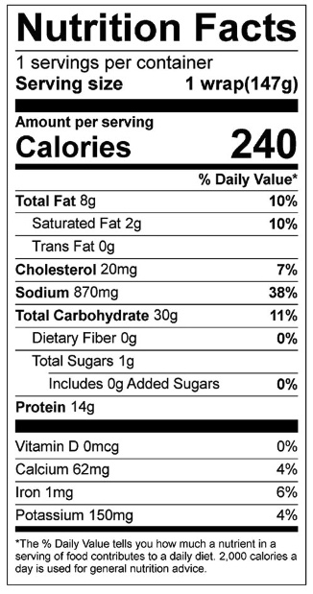
Example
Notes:
Items meaning
Wrapped
meaning

Slide 24
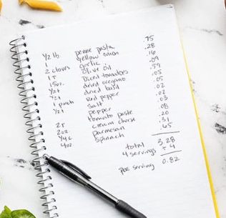
TypedData two main pillars
Data Type plugins
Data definitions
TypedDataManager

Slide 25
Code example

Slide 26
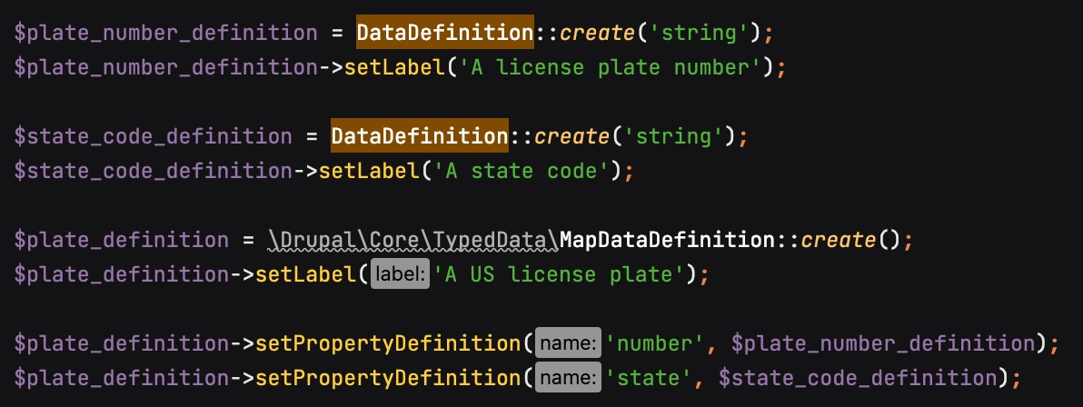
Code example

Slide 27
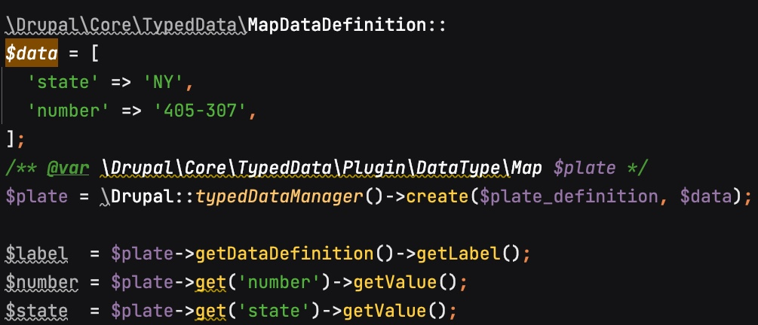
Code example

Slide 28
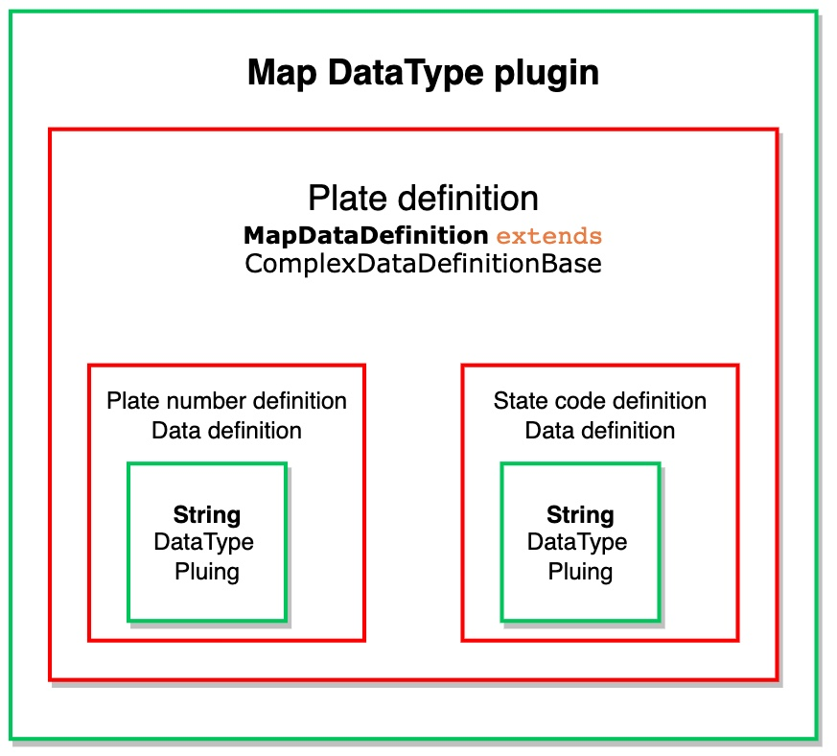
Code example as diagram

Slide 29
Entity API on top of TypedData API
Notes:
entity on top typed
other and other
debuging

Slide 30
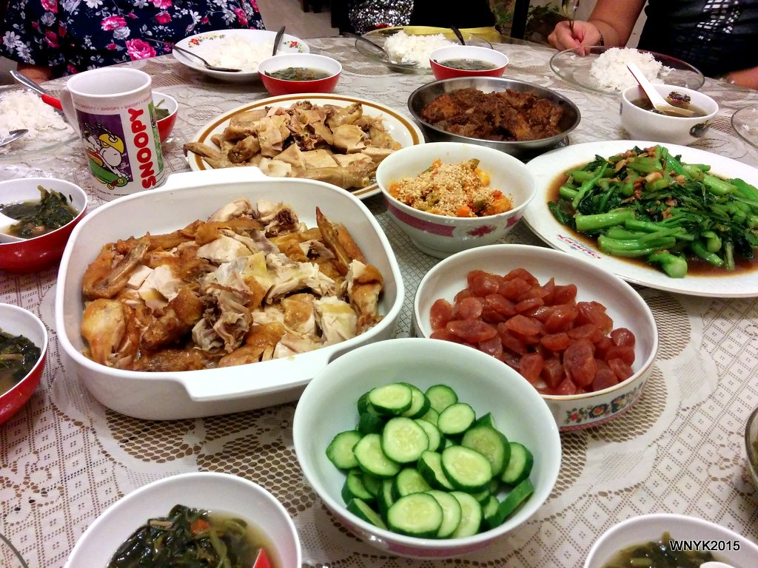
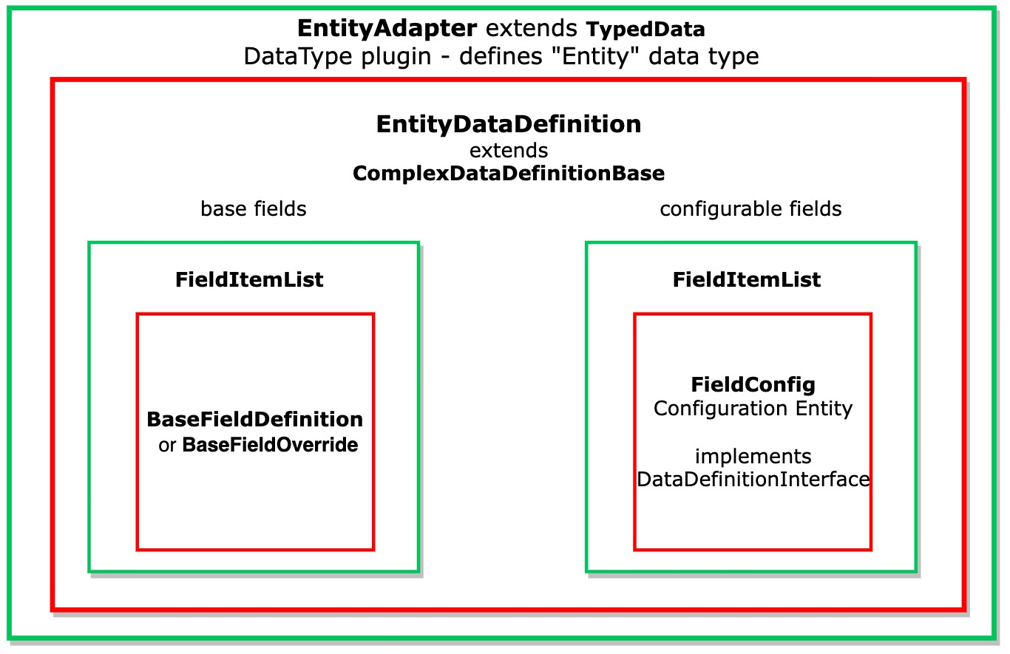
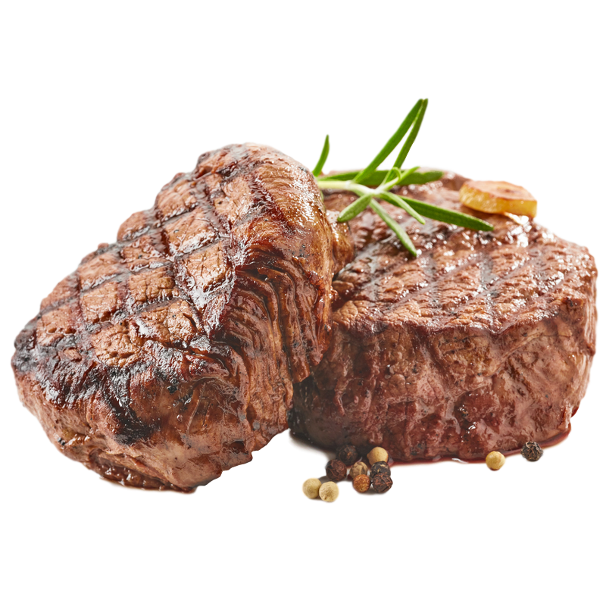
Content entities

Slide 31
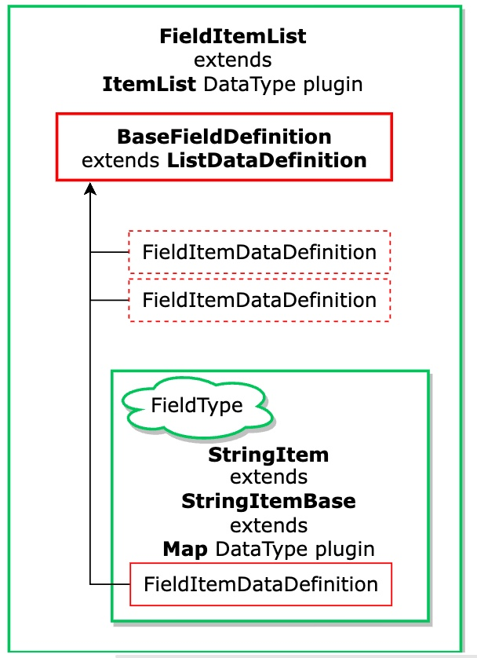
Base field
Notes:
Entity API on top of TypedData API

Slide 32
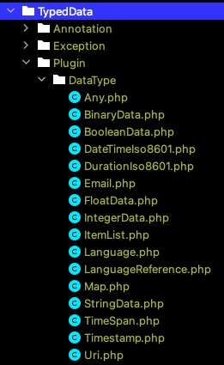
Core Data Type plugins

Slide 33
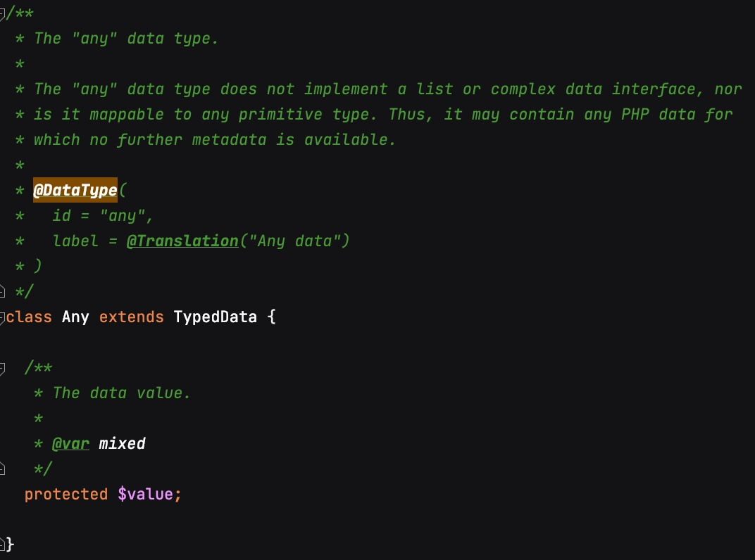
Core Data Type plugins

Slide 34
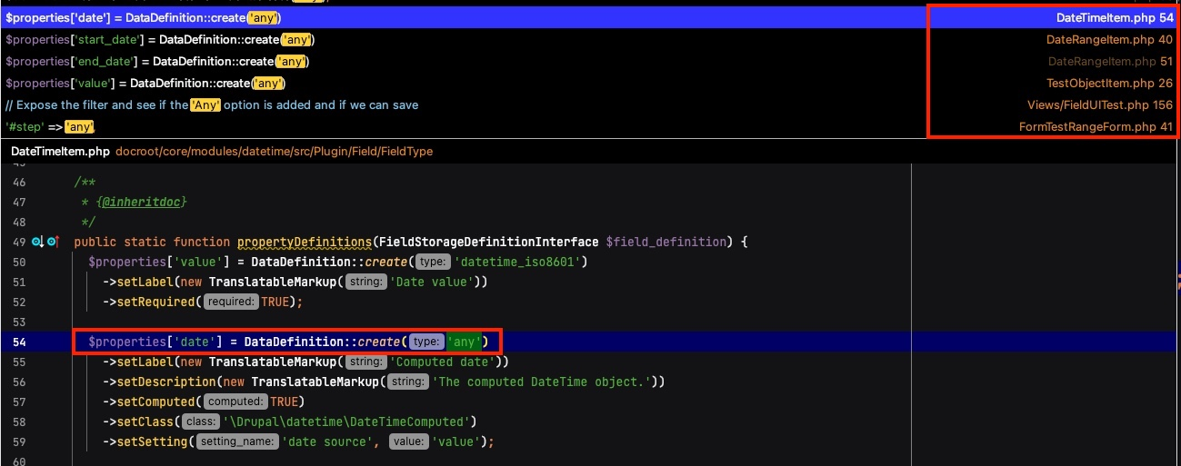
Core Data Type plugins

Slide 35
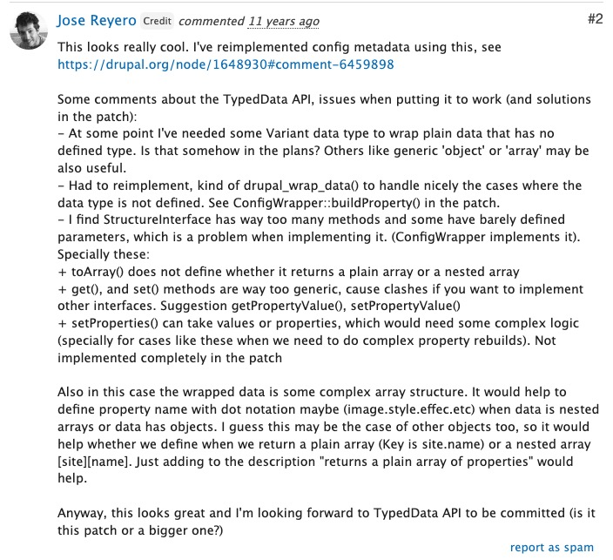
Core Data Type plugins

Slide 36
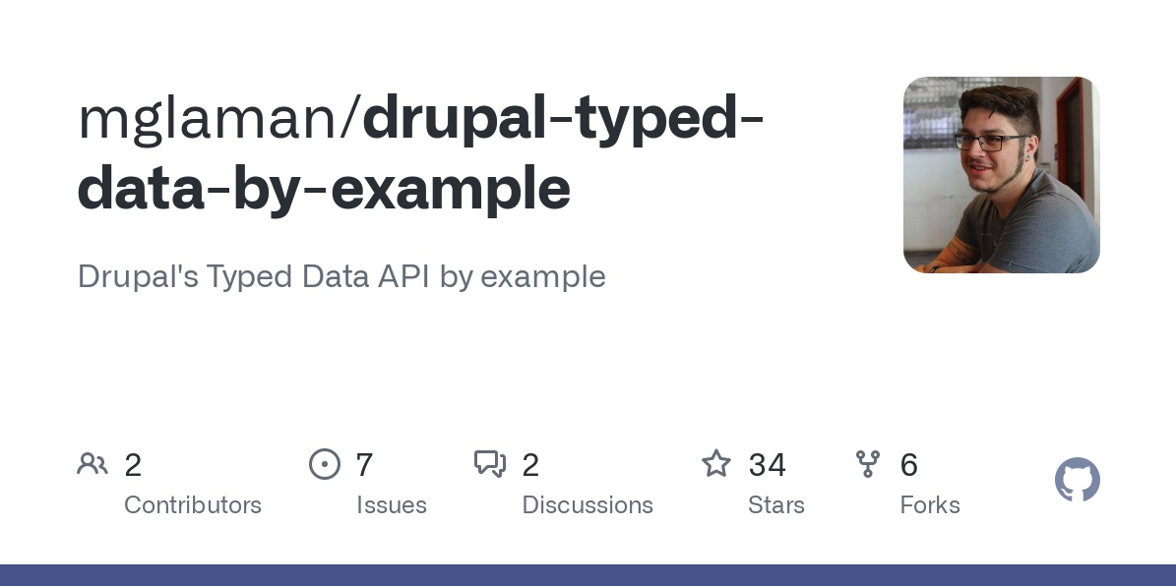
TypedData by example
Notes:
https://github.com/mglaman/drupal-typed-data-by-example

Slide 37
TypedData by example
Notes:
https://github.com/mglaman/drupal-typed-data-by-example

Slide 38
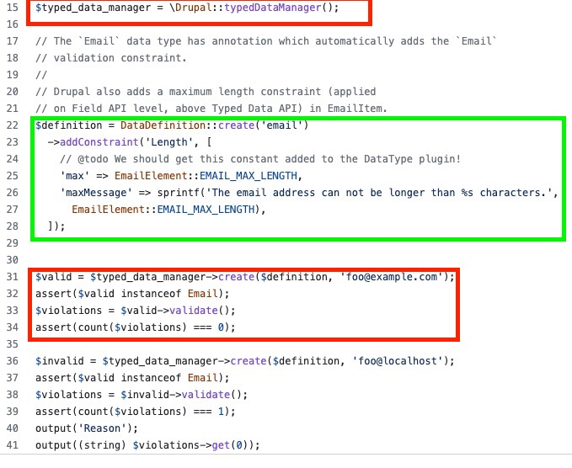
TypedData by example
Notes:
https://github.com/mglaman/drupal-typed-data-by-example

Slide 39
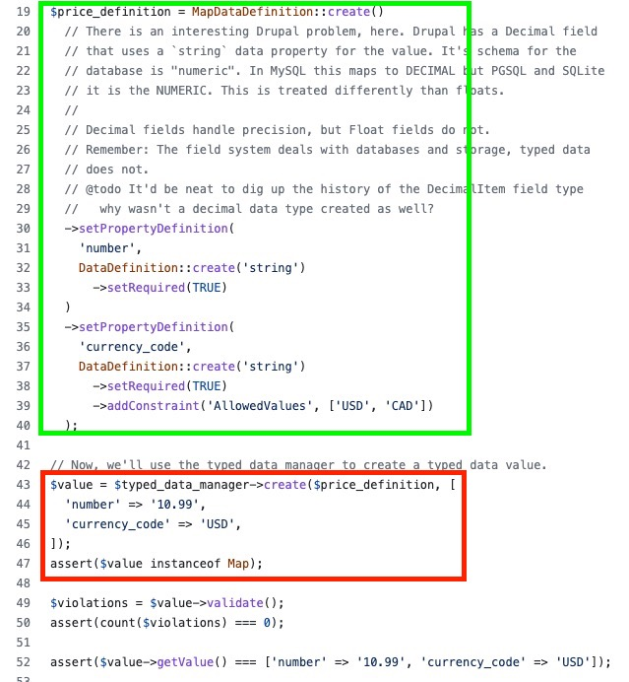
TypedData by example
Notes:
https://github.com/mglaman/drupal-typed-data-by-example

Slide 40
Usecase: TypedData by Fivejars
https://fivejars.com/blog/typed-data-api-drupal-8
Notes:
https://fivejars.com/blog/typed-data-api-drupal-8

Slide 41
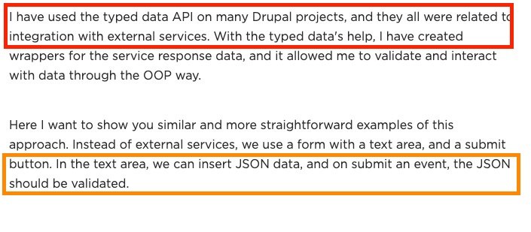
Usecase: TypedData by Fivejars
Notes:
https://fivejars.com/blog/typed-data-api-drupal-8

Slide 42
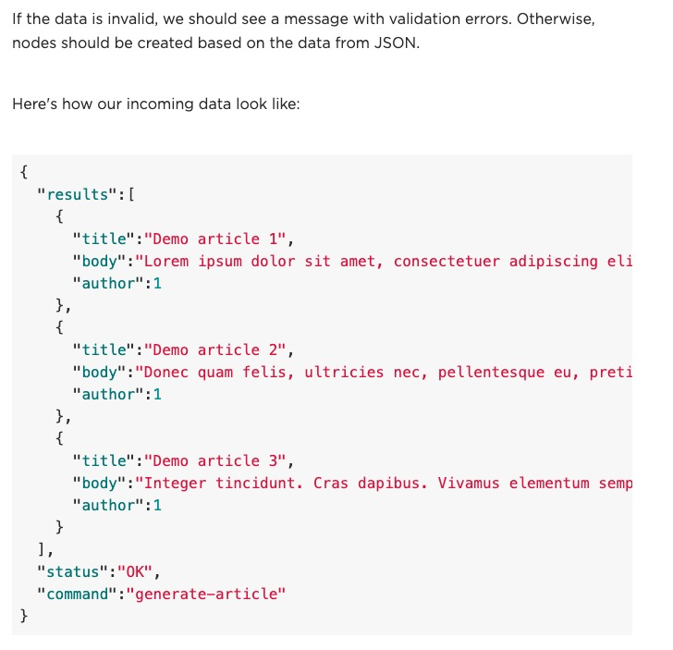
TypedData by Fivejars
Notes:
https://fivejars.com/blog/typed-data-api-drupal-8

Slide 43
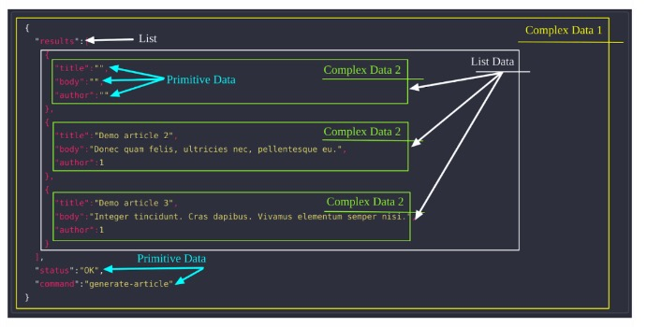
Usecase: TypedData by Fivejars
Notes:
https://fivejars.com/blog/typed-data-api-drupal-8

Slide 44
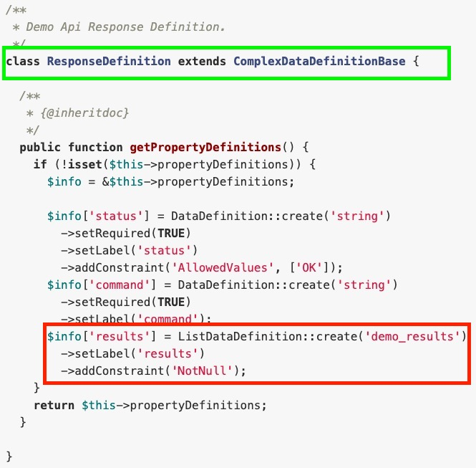
TypedData by Fivejars
Notes:
https://fivejars.com/blog/typed-data-api-drupal-8

Slide 45
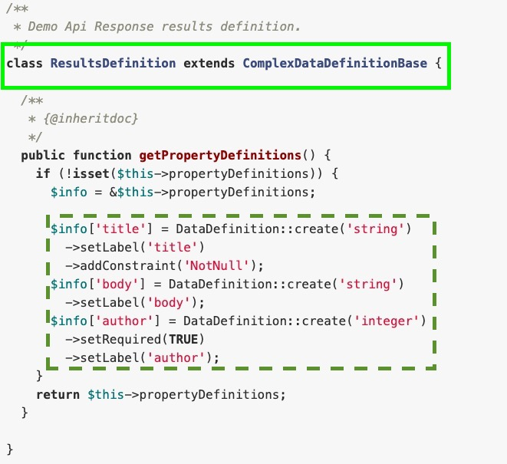
TypedData by Fivejars
Notes:
https://fivejars.com/blog/typed-data-api-drupal-8

Slide 46
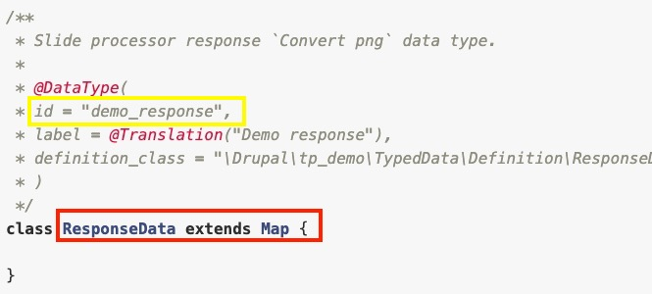
Usecase: TypedData by Fivejars
Notes:
https://fivejars.com/blog/typed-data-api-drupal-8

Slide 47
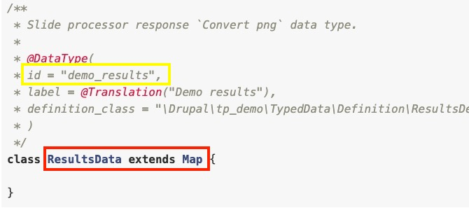
Usecase: TypedData by Fivejars
Notes:
https://fivejars.com/blog/typed-data-api-drupal-8

Slide 48
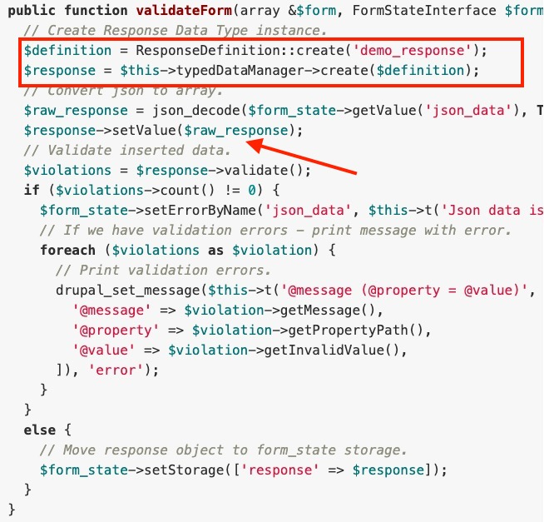
TypedData by Fivejars
Notes:
https://fivejars.com/blog/typed-data-api-drupal-8

Slide 49
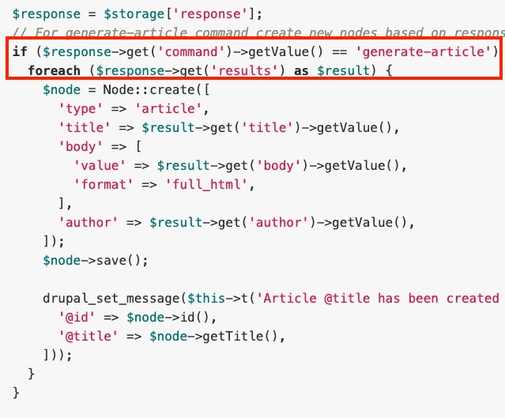
TypedData by Fivejars
Notes:
https://fivejars.com/blog/typed-data-api-drupal-8

Slide 50
Thank you!
Questions?

